Slide 1

Recitation 7 /////

Slide 2
Announcements
HW02 due Thursday (10/07)
HW03 released Friday and due next Thursday (10/14)
Exam 2 next Friday (10/15)
No recitation next week due to Fall Break

Slide 3

Recitation Feedback Form!
https://forms.office.com/r/e5BbxW3DAx

Slide 4
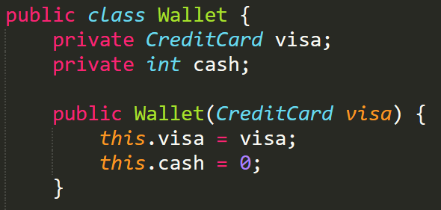
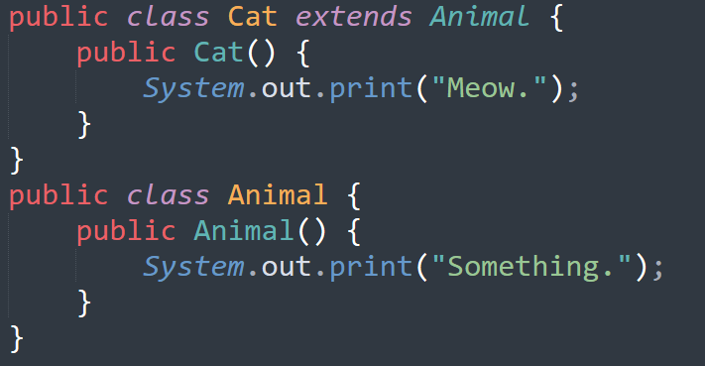

Topic Trivia
Is the Wallet constructor creating a shallow
or deep copy of its instance var visa?
Is the following autoboxing or unboxing?
What is the Object class and how does it play a role in Inheritance?
What gets printed when we create a Cat object?
If two methods in the same class have the same method signature, are they overridden methods?

Slide 5
Topic Trivia
Is the Wallet constructor creating a shallow
or deep copy of its instance var visa?
Is the following autoboxing or unboxing?
What is the Object class and how does it play a role in Inheritance?
What gets printed when we create a Cat object?
If two methods in the same class have the same method signature, are they overridden methods?
shallow
unboxing
All classes implicitly extend Object. If you do not implement methods such as equals() or toString() you can still call them because they inherit Object’s implementation
Something.Meow.
No, overridden methods occur in a superclass and subclass

Slide 6
Topic List
Aliasing (deep/shallow copy)
Wrapper classes
Inheritance
JavaDocs
Packages
More visibility modifiers (protected/default)
Overriding

Slide 7
Aliasing
Occurs when two or more references point to same location in memory
Common examples we've seen before:
String s1 = new String("string1");
String s2 = s1;
s1 == s2; //will return true
int[] a1 = {1,2,3,4,5};
int[] a2 = a1;
a2[3] = 0; //a1 = {1,2,3,0,5} AND a2 = {1,2,3,0,5}

Slide 8
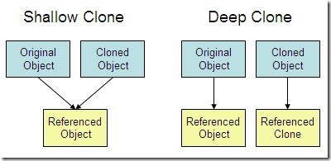
Shallow vs Deep Copies
A shallow copy is created by directly copying the reference to the original object
A deep copy is instantiated on its own (has its own unique reference) but holds the same value as the original.
Shallow copies can create problems because modifying any members of the copied/original object will modify both the original and copy!

Slide 9
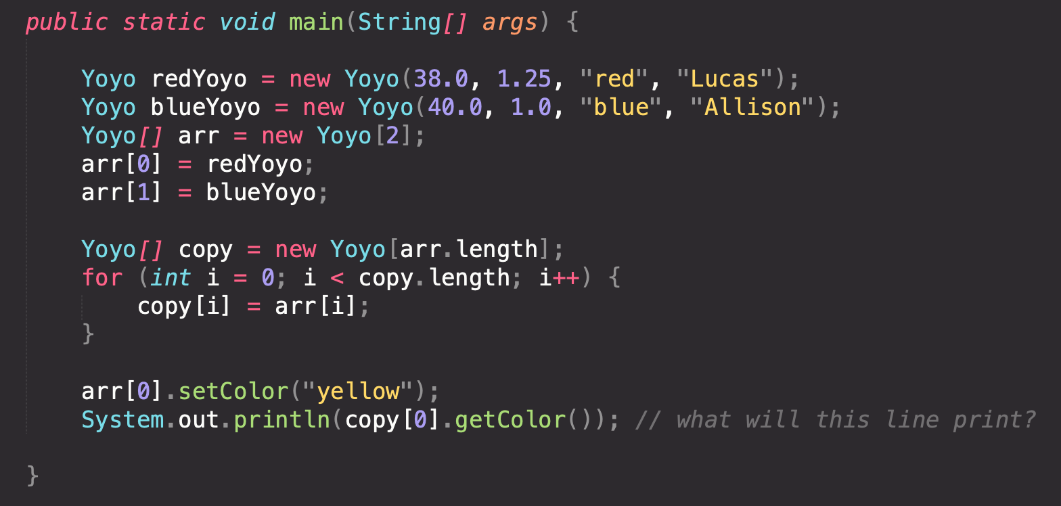
Shallow Copy Array

Slide 10
Shallow Copy Array
Yoyo[] arr = new Yoyo[2];
Yoyo[] copy = new Yoyo[arr.length];
redYoyo
stringLength = 38.0;
radius = 1.25;
color = “red”;
owner = “Lucas”;
"yellow";
blueYoyo
stringLength = 40.0;
radius = 1.25;
color = “blue”;
owner = “Allison”;
When arr[0].setColor("yellow"); is called, it will change the redYoyo instance and so both arr and copy will be changed. Now copy no longer holds the original values of the array.

Slide 11
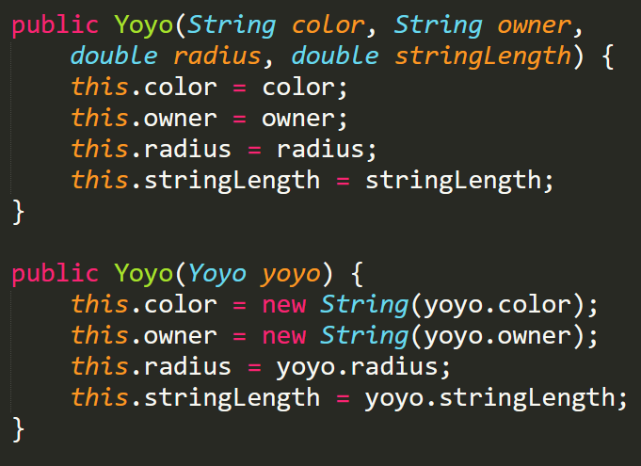
Deep Copies (Copy Constructors)
Instead, use deep copies to create a new identical instance of our object and its instance variables to avoid the issues of aliasing
We may need to add a constructor to specifically create copies
Yoyo redYoyo = new Yoyo("red", "Akul", 2.5, 35.5);
Yoyo deepCopyRedYoyo = new Yoyo(redYoyo);
deepCopyRedYoyo.setColor("green");
System.out.println(redYoyo.getColor());
//will print "red"

Slide 12
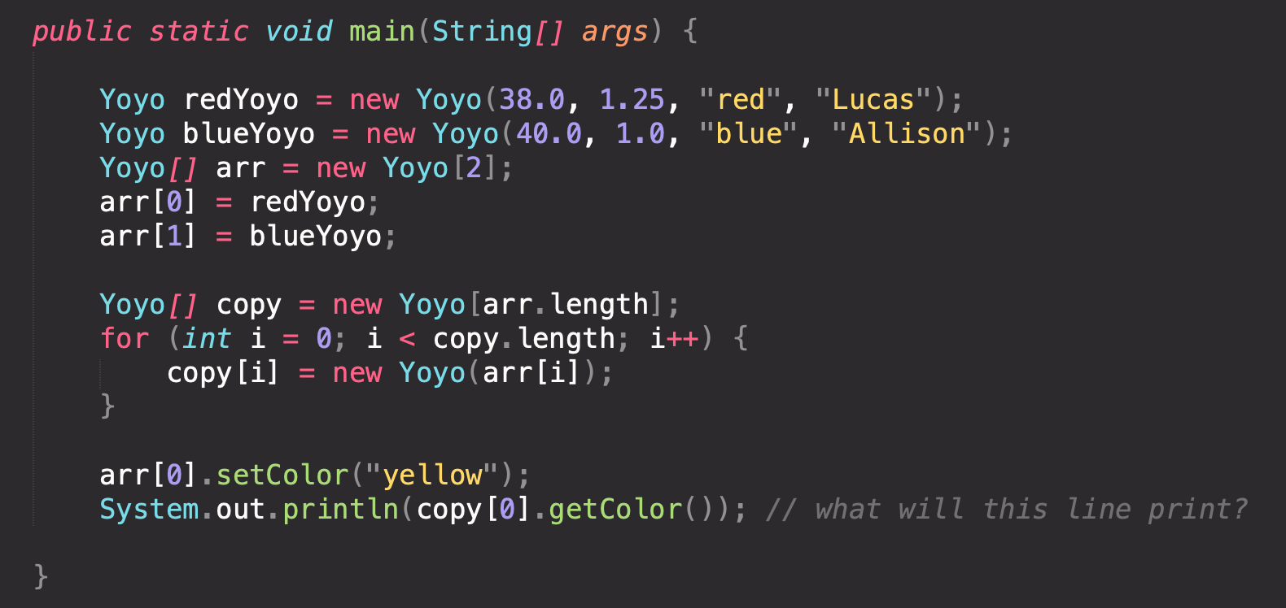
Deep Copy Array
To make a deep copy of arrays, you'll need to iterate through each element in the array!

Slide 13
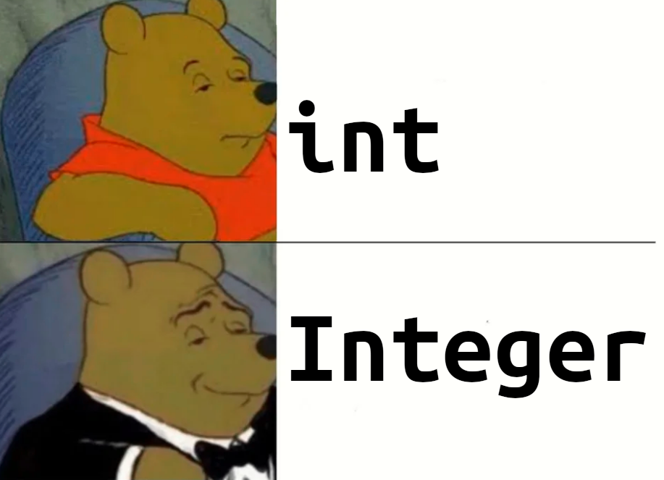
Wrapper Classes
A wrapper class holds the same data as a primitive, but is an object
This means you can call methods on it
There is a corresponding wrapper class for every primitive type:
int -> Integer
double -> Double
char -> Character
boolean -> Boolean
Each of these wrappers lives in java.lang
No need to import

Slide 14
Autoboxing / Unboxing
Java automatically converts between primitive and wrapper types when needed:
Integer num1;
int val = 5;
num1 = val; //autoboxing: 5 is converted from int to Integer
Integer num2 = Integer.valueOf(-4);
int myVal = num2; //unboxing: -4 is converted from Integer to int

Slide 15
Helpful wrapper methods
int num = Integer.parseInt(String word);
Takes in a String that contains an int (e.g. "35")
Returns an int that we can use for computation
String s = Integer.toBinaryString(int i);
Takes in an int and returns a String holding the binary (base 2) representation of the int
Integer.toBinaryString(10) -> "1010"

Slide 16
Inheritance
Classes can extend other class
Parent Class (aka super class): the class being extended
Child Class (aka subclass): the class extending the parent class
Classes then "inherit" the methods and data from the class that they extend
If a method is in the parent class, the child will also have that method
A child class is said to inherit these methods and fields
Inheritance only occurs when the method/data is public or protected
We use inheritance because it allows for code reuse and reduces repetition
If we need to change a method, we only need to change it in one place in the parent class

Slide 17
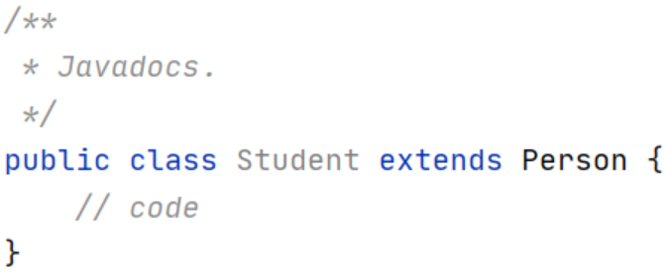
Inheritance (Continued)
Use the extends keyword in the class header to inherit

Slide 18
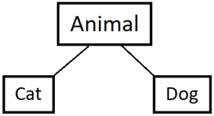
Inheritance (Continued)
A parent class can have many child classes
A child class can only have one parent class (single inheritance)
Parent/superclass
Child/subclass
Child/subclass

Slide 19
Inheritance (Continued)
Use the super keyword to access the superclass's non-private methods/data
Use super() for constructor invocation of the superclass's constructor
Note: either super() or this() must be the first line of the constructor. If you don't include this, java will insert one for you, whether the parent has a no args constructor or not
public class Cat extends Animal {
public Cat() {
super();
}
// more code
}

Slide 20
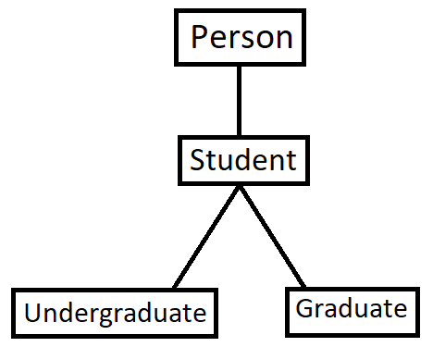
Inheritance (Continued)
A class can be both a child and a parent class
(All classes extend the Object class!)
Superclass of Undergraduate and Graduate
Subclass of Person

Slide 21
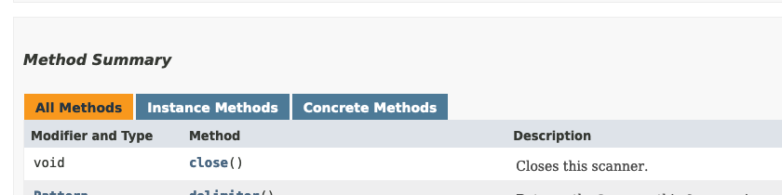
Javadocs
A special kind of comment placed above a method, field, or class
Explains the functionality
Gives extra information about method parameters and return value
Helps other developers understand your code
Javadocs can have tags
Tags allow you to describe things like the return value, the parameters, class authors, and version
Ex. @return, @param [name], @author, and @version
Javadocs allow you to create neatly styled documentation

Slide 22
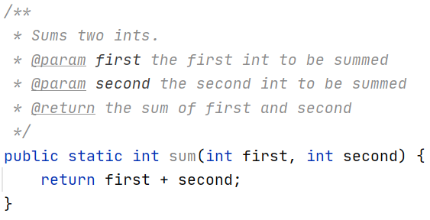
Javadocs Example

Slide 23
Packages
Useful for grouping together classes with similar purposes or functions
In order to create a package :
Create a folder that is the name of the package
Place all classes inside the folder you make
Include the package <folder name> at the top of each class in the package (folder)
When compiling you must tell Java where to find the package you want to use (classpath)
By default Java will look in the current working directory

Slide 24
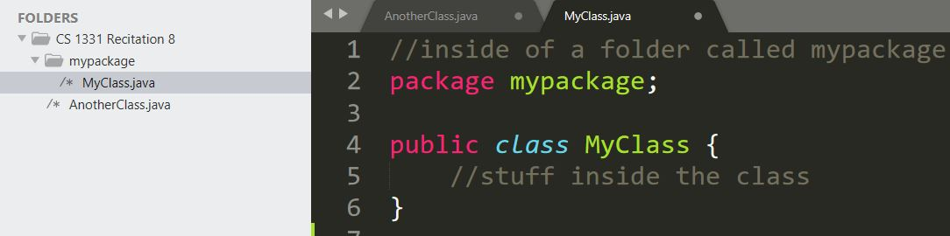
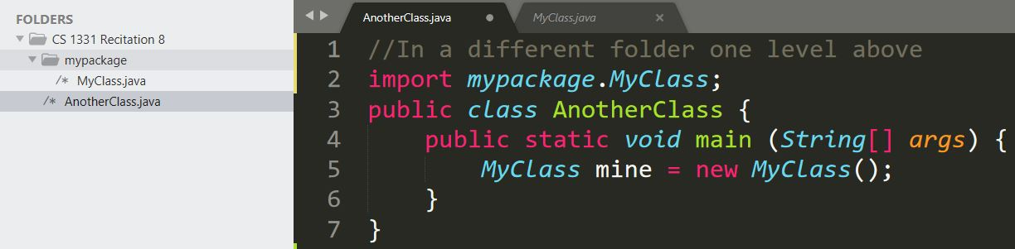
Example (Creating Packages):

Slide 25
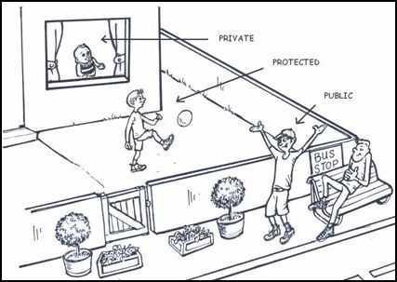
Additional Visibility Modifiers
protected - accessible to subclasses and all classes in the same package (but not to outsiders!)
Subclass always inherit protected data (methods, instance data, etc.)
default (AKA package private) - accessible to all classes in the same package
Subclasses only inherit package private members if they are in the same package

Slide 26
Visibility Modifiers (Continued)
 | Private | Protected | Public | Default
Inherited by subclass | ✗ | ✓ | ✓ | within same package
Accessible by classes in the same package | ✗ | ✓ | ✓ | ✓
Accessible by any class | ✗ | ✗ | ✓ | ✗

Slide 27
Overriding
A subclass can override a method from its parent class
It has the same method name, same parameters but different implementation
Signify an overridden method to the compiler with the @Override tag
Note: static methods and final methods cannot be overridden
Method Overriding | Method Overloading
Same Method Signature (Different Implementation) | Different Method Signature (Different Parameters)
Within subclass | Within the same class or with a parent-child relationship

Slide 28
Coding Activity
TA's will now do live coding!

